Slide 1

Analysing Energy Trends in Singapore
Ernest Pek Jun Wei
B1981095

Slide 2

Analysing Energy Trends in Singapore
This presentation covers the methodology and findings of an analysis of energy consumption and capacity, including historical trends and future projections. It covers a comparison of surplus and deficit with forecasted values and ARIMA model, and highlights how this analysis can inform policymakers and energy providers.

Slide 3
The Business Problem
The demand for electricity in Singapore is increasing steadily due to population growth and urbanization.
Policymakers and energy providers need a comprehensive understanding of the energy landscape and accurate forecasts to meet the country's growing electricity demands.

Slide 4
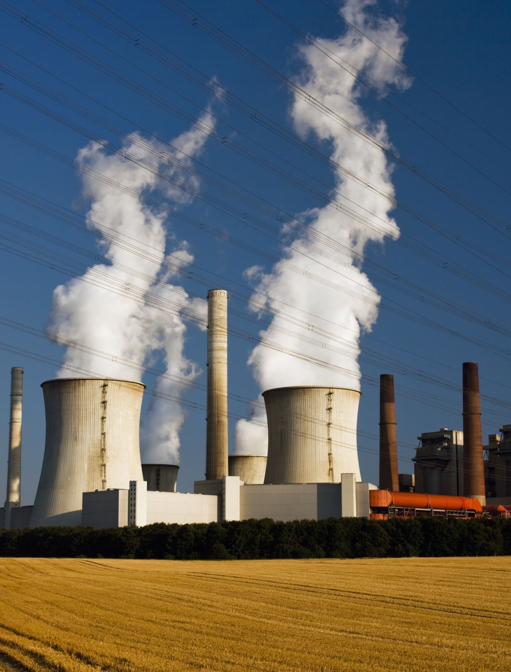
Historical Data
Historical data on energy consumption, population growth rate and power plant capacities were examined and pre-processed by removing outliers, interpolating missing values, and calculating average consumption for each year.

Slide 5
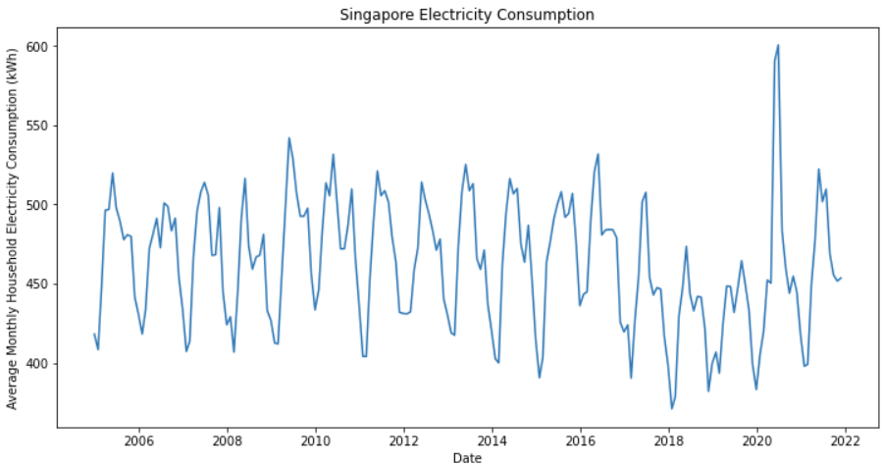
Average Monthly Household Electricity Consumption
(kWh)
Source: Energy Market Authority

Slide 6
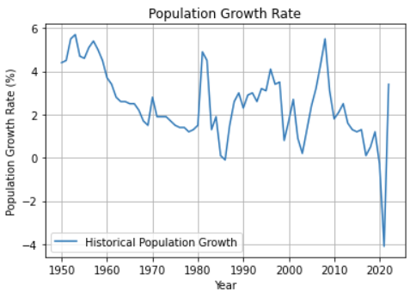
Singapore Population Growth Rate (1950-2021)
Source: Singapore Department Of Statistics

Slide 7
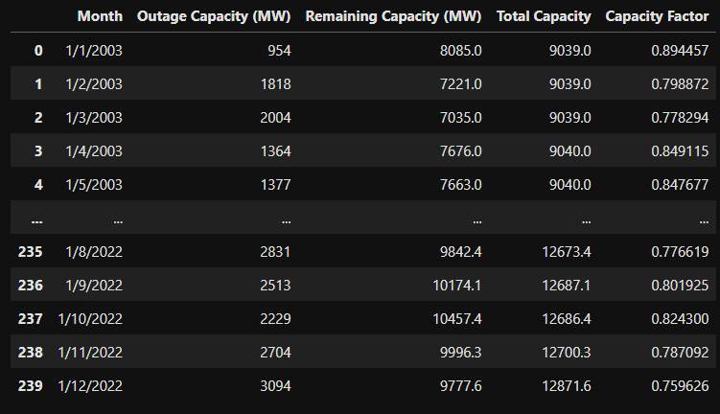
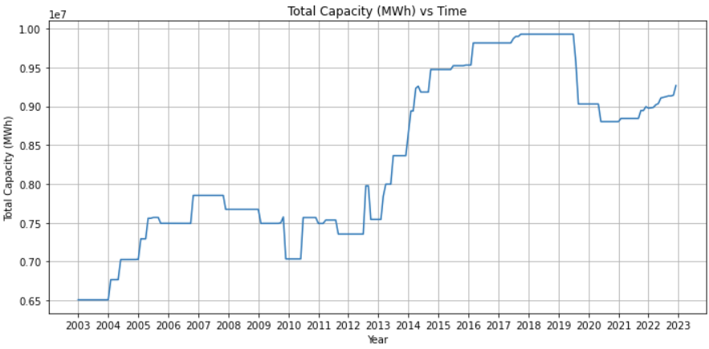
Total Capacity (MWh)
&
Capacity Factor
Source: Energy Market Authority
*assumption that there were 30 days every month for the conversion to MWh

Slide 8
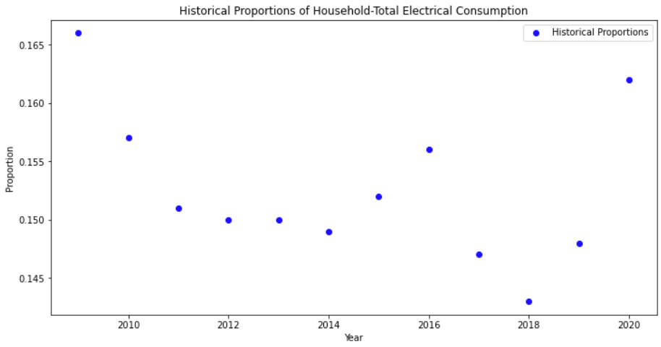
Ratio of Household : Total Electrical Consumption
Source: Energy Market Authority

Slide 9

Effects of COVID-19 Pandemic
- Outliers in electricity consumption and population growth rate and the proportion of household to total consumption were noticed in 2020 due to the impact of the COVID-19 pandemic.

Slide 10
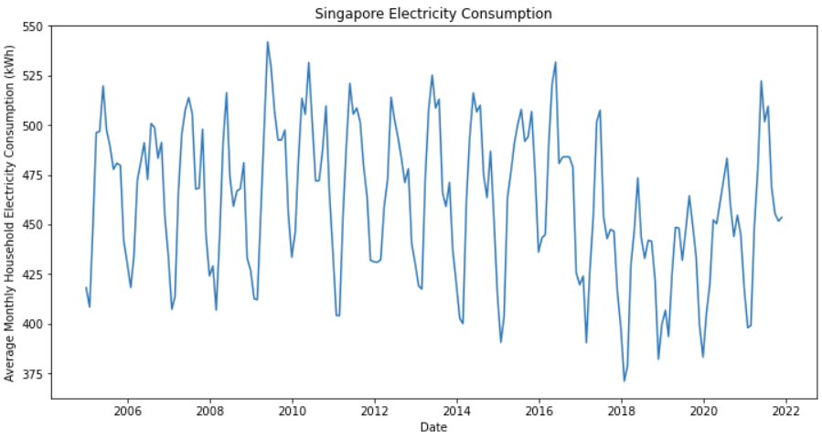
Replacing Outliers
Using linear interpolation to replace the outliers

Slide 11
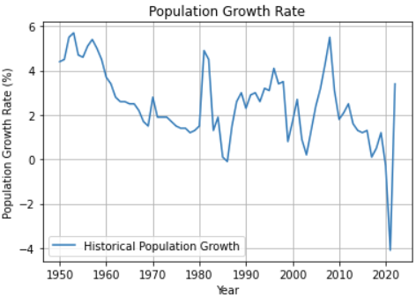
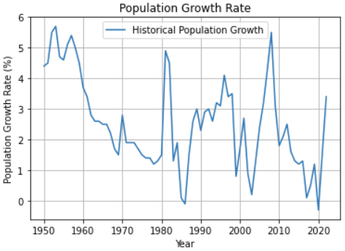
Replacing Outliers
Using linear interpolation to replace the outliers

Slide 12
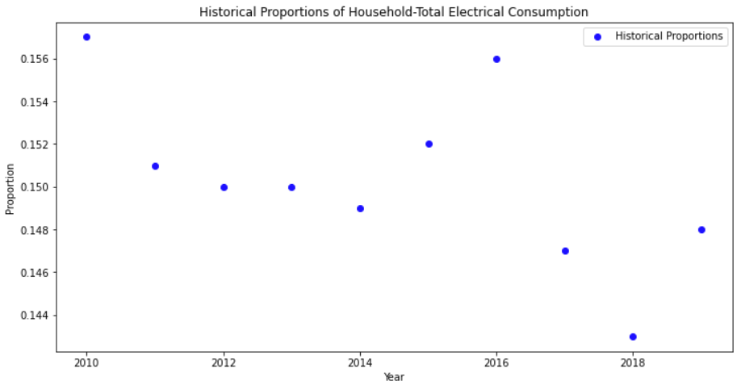
Removing Outliers

Slide 13
Methodology
Using SARIMA to predict the future household electricity consumption
Using SARIMA to predict the future population growth and in turn, the total number of households in the future
Total future household consumption

Slide 14
Methodology
Using SARIMA to predict the future generating capacity of the power plants
Using linear regression to predict the future Household-Total proportion
Using Monte Carlo Simulation to simulate the capacity factor in future periods
Total future household capacity

Slide 15

Methodology
Total future household capacity - Total future household consumption
= Future Surplus/Deficit

Slide 16
Using pmdarima’s auto arima to get the best model
Best model obtained: ARIMA(2,1,2)(3,1,1)[12] based on the lowest Akaike Information Criterion (AIC)
Mean Squared Error: 1046.19
Mean Absolute Percentage Error: 6.15
Root Mean Squared Error: 32.34

Slide 17
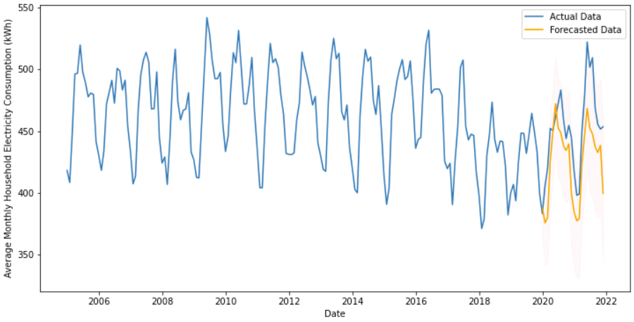
SARIMA Model for Household Electrical Consumption

Slide 18
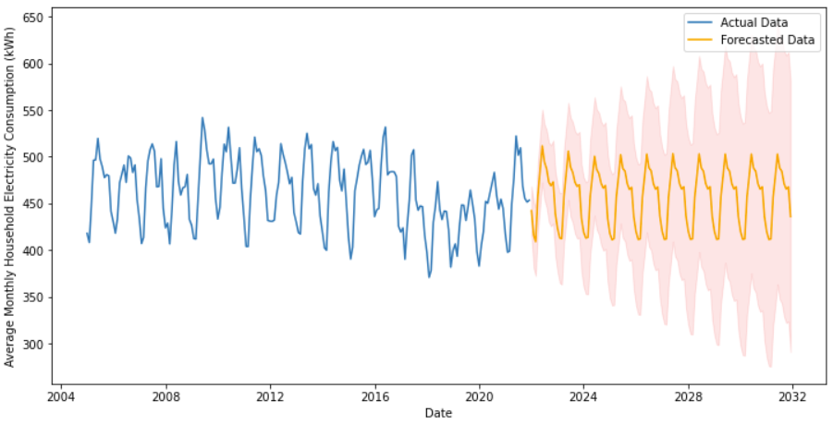
Forecasting the household consumption data

Slide 19
Using auto arima to get the best model for Population Growth Rate
Best model obtained: ARIMA(0,1,0)(1,1,0)[12] based on the lowest Akaike Information Criterion (AIC)

Slide 20
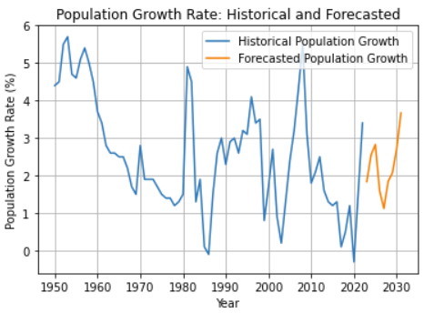
SARIMA Model for Population Growth Rate

Slide 21
Using auto arima to get the best model for Total Capacity
Best model obtained: ARIMA(1,1,0)(0,1,3)[12] based on the lowest Akaike Information Criterion (AIC)

Slide 22
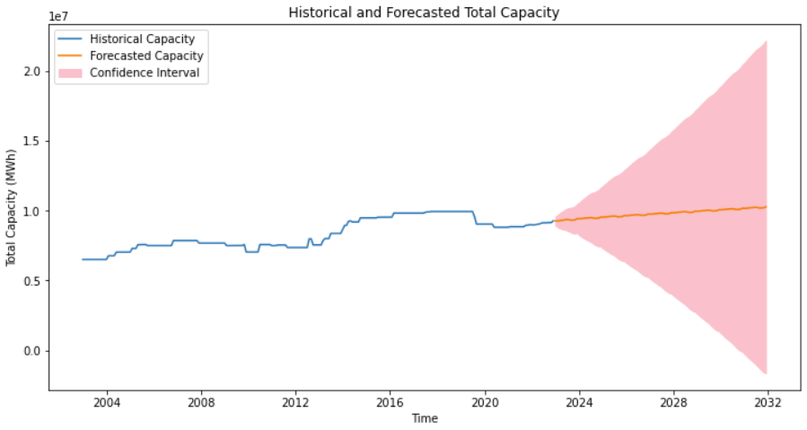
SARIMA Model for Total Capacity

Slide 23
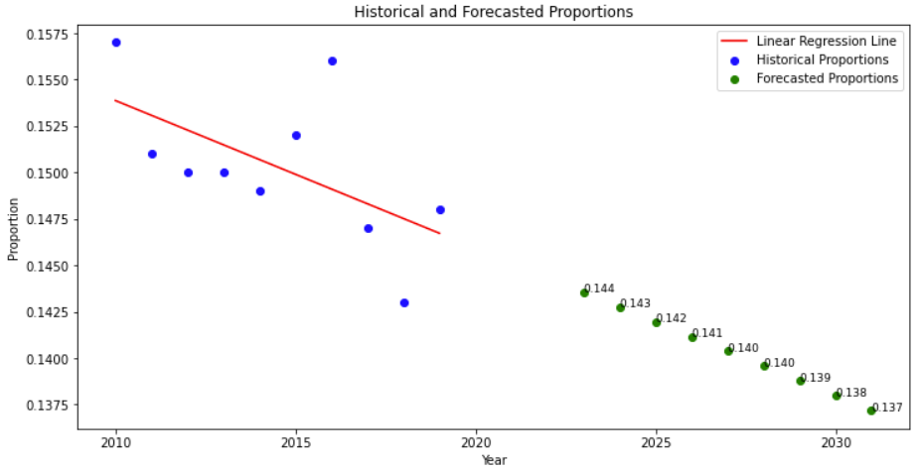
Linear Regression for Household:Total Proportion

Slide 24
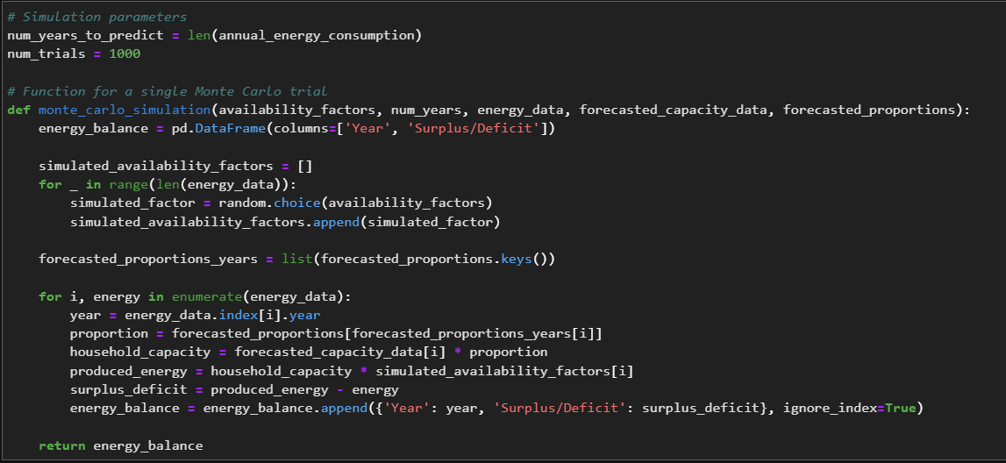
Monte Carlo Simulation for Capacity Factor

Slide 25
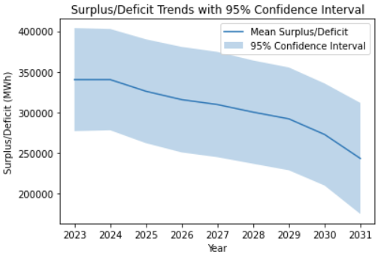
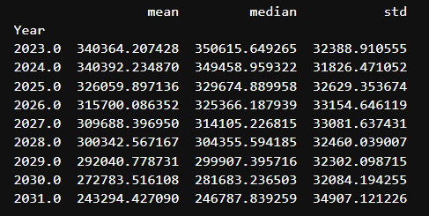
Monte Carlo Results

Slide 26
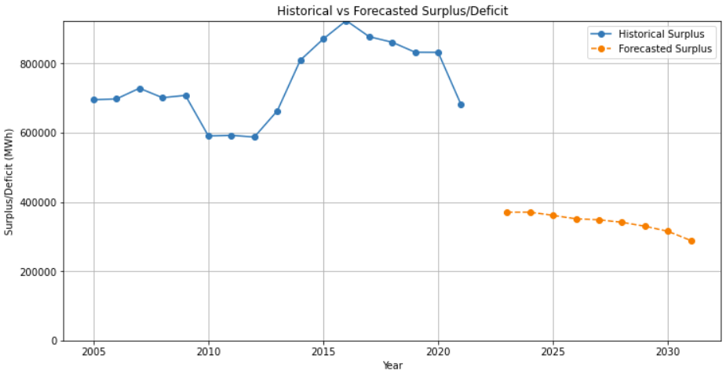
Historical vs Forecasted Surplus

Slide 27
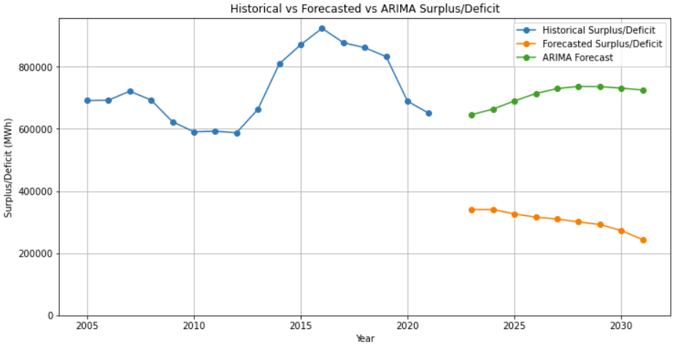
Historical vs Forecasted vs ARIMA Surplus

Slide 28
Informing policymakers and energy providers
The analysis provided can inform policymakers and energy providers in developing strategies for meeting the country's growing electricity demand.
Data-driven insights can support decision-making and resource allocation.

